Slide 1
Nitrogen Removal in Anaerobic Ammonium Oxidation Bioreactors
Austin Dougless with
Jim Field, José Carvajal-Arroyo,
Guangbin Li, David Vilcherrez, Daniel Puyol
Department of Chemical and Environmental Engineering
NASA Space Grant Research Symposium
The University of Arizona
April 12, 2014

Slide 2
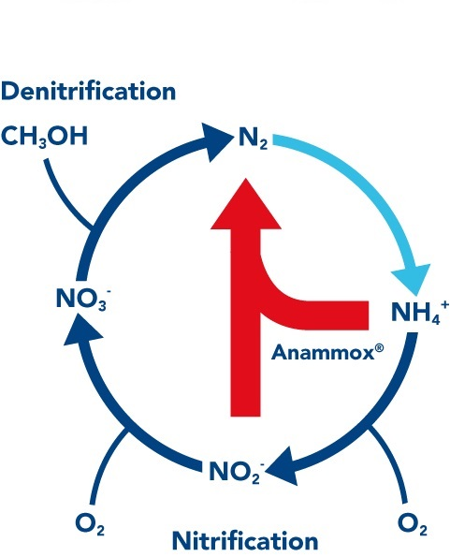
Anaerobic Ammonia Oxidation
Notes:
Abbreviated as the “anammox” process
Utilizes bacteria that convert NH₄⁺ and NO₂⁻ into N₂
Anaerobic process and inorganic carbon source
Advantageous over standard nitrification-dentrification process
Energy savings, no additional electron donor needed
NH₄⁺ and NO₂⁻ are prevalent contaminants in many effluent streams

Slide 3
Objectives
Monitor the ability of anammox bacteria to remove aqueous NH₄⁺ and NO₂⁻ under standard operating conditions
pH, nitrogen loading rate, temperature, light
Determine key performance parameters
Stoichiometric conversion ratio, conversion efficiency, specific anammox activity (SAA), N₂ production
Explore substrate inhibition by NO₂⁻

Slide 4
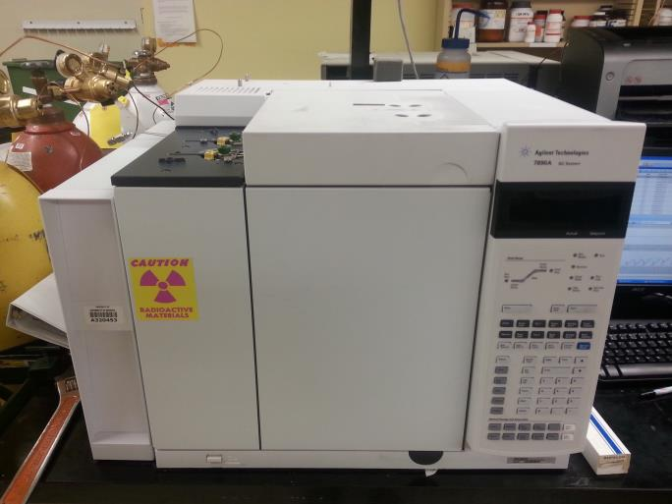
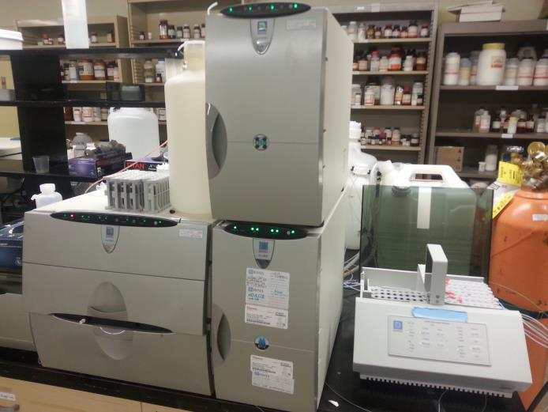
Methods
Maintain two expanded granular sludge bed (EGSB) reactors at standard operating conditions
Gas Chromatography
Ion Chromatography
Notes:
Analyze substrate concentrations using ion chromatography
Measure batch activity using gas chromatography

Slide 5
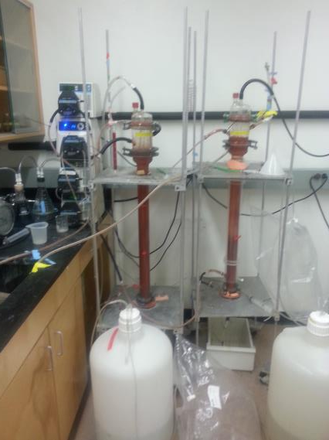
Pumps
Gas meter
Influent tanks
Pictured: Reactors, influent tanks/pumps, recycle pumps, gas collection system

Slide 6
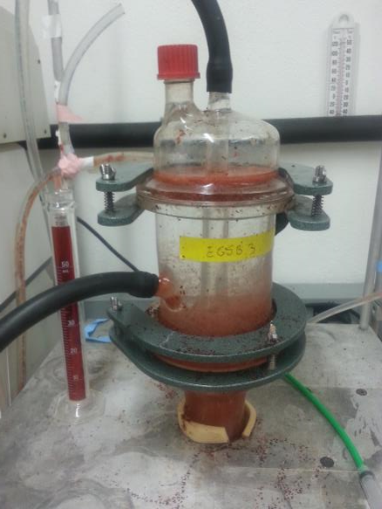
50 mL graduated cylinder for scale
Pictured: Top of reactor, gas collection tubing, recycle tubing

Slide 7
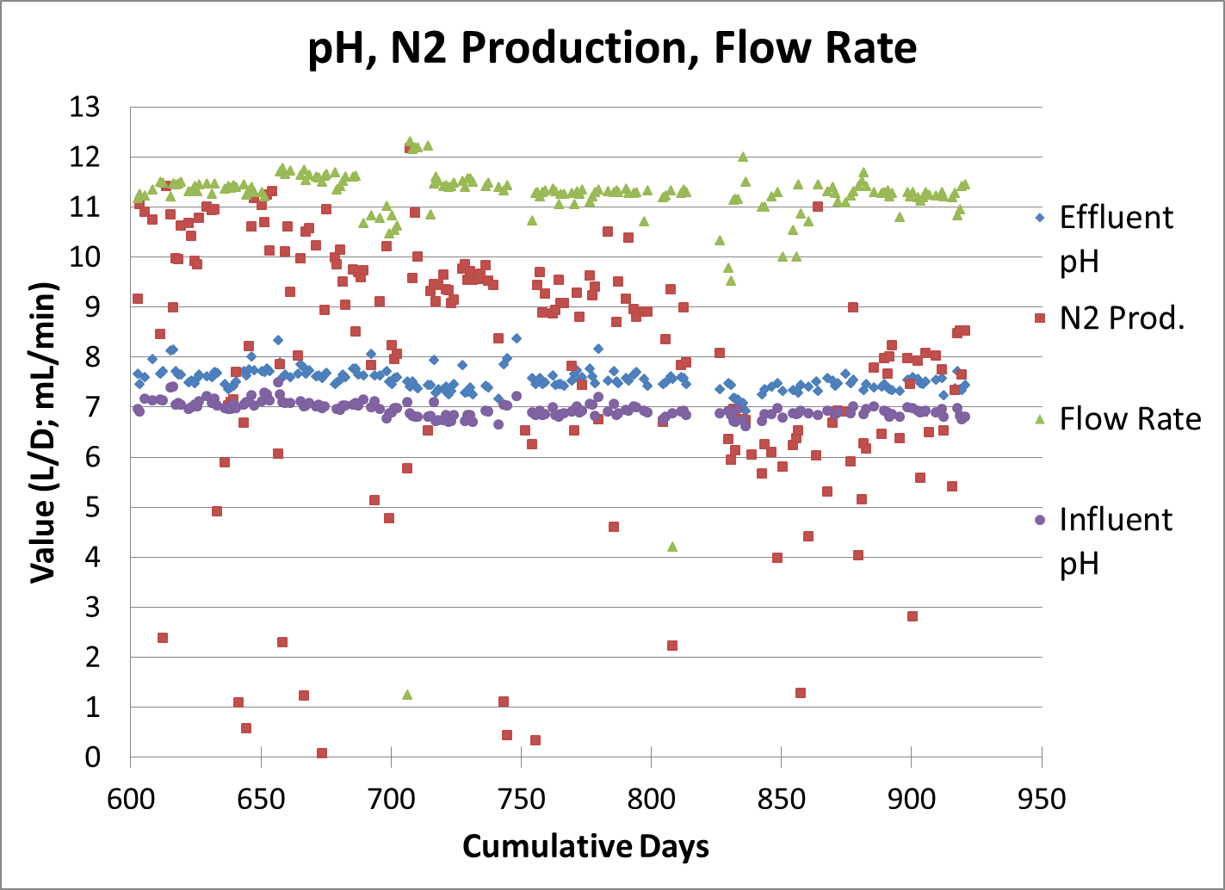
EGSB Reactors

Slide 8
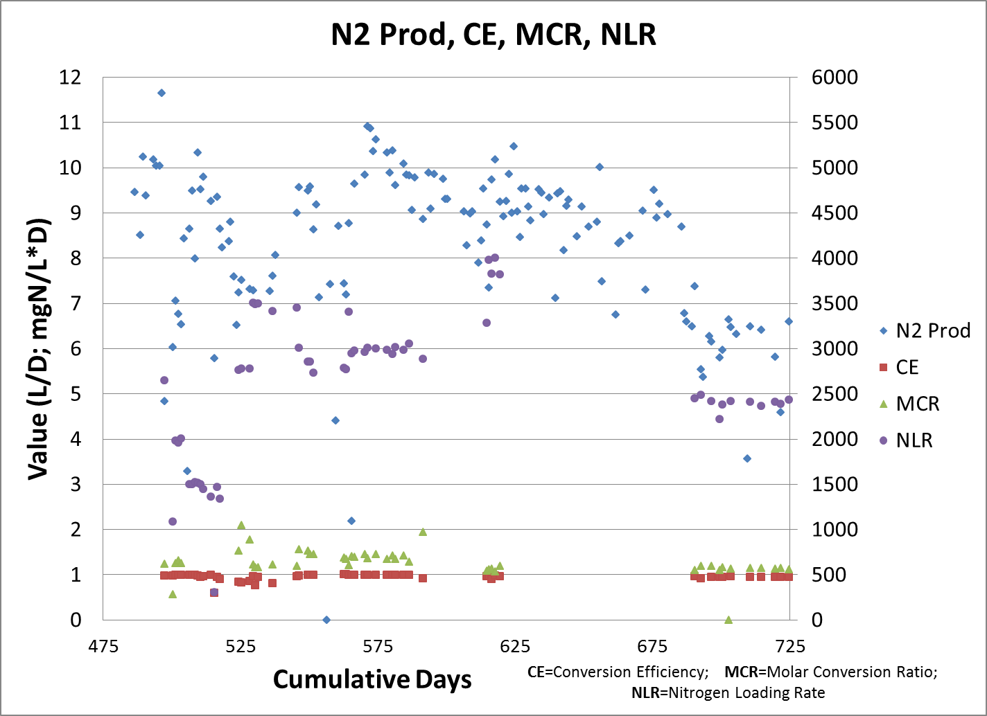
EGSB Reactors Cont.

Slide 9
Nitrite Inhibition
Exposure to nitrite alone is highly inhibitory at even low concentrations
The presence of nitrate (a by product of the reaction) alone is mildly inhibitory
Pre-exposure to NO₃⁻ prior to NO₂⁻ exposure can lessen the NO₂⁻ inhibitory effect

Slide 10
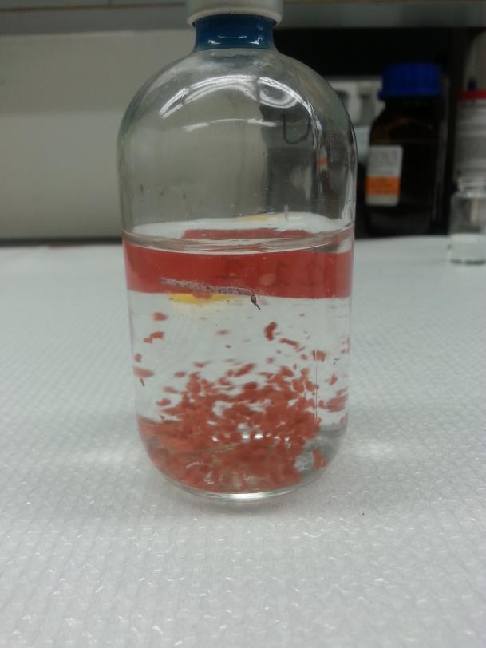
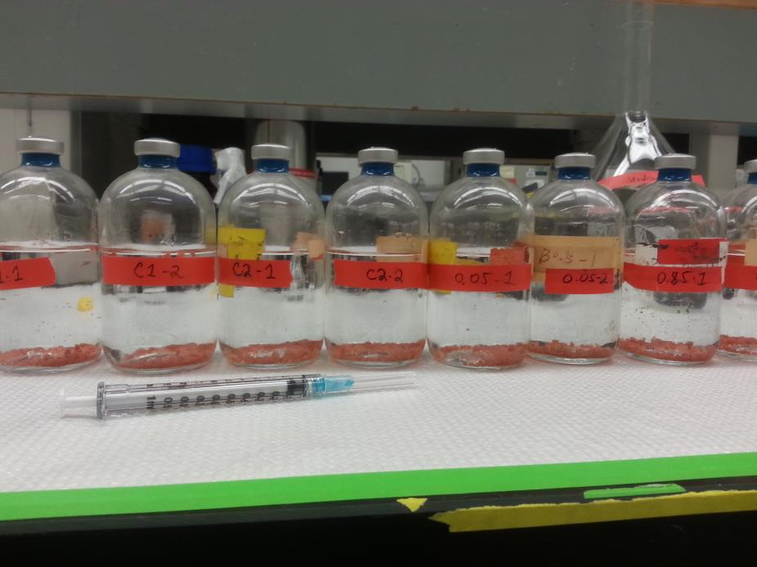
160mL serum bottles
Anammox biomass

Slide 11
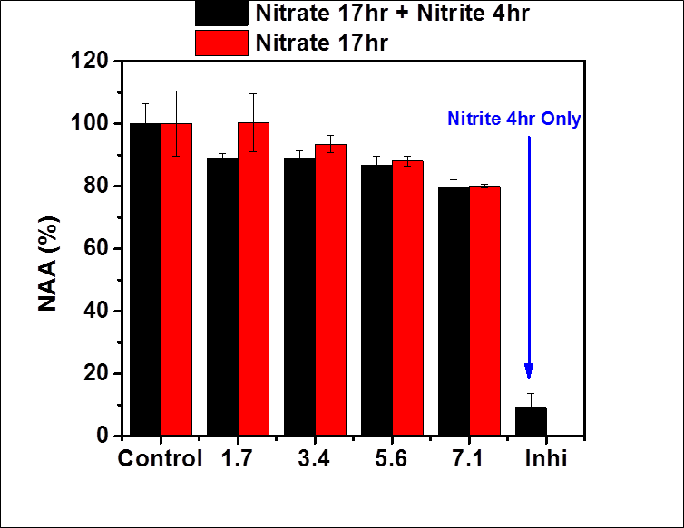
Inhibition Results
Concentration (mM)

Slide 12
Significance
Key operating elements of the anammox process have been established
Standard performance parameters have been documented
NO₃⁻ pre-exposure for at least 17 hours decreases inhibition due to NO₂⁻
These findings help determine normal functioning of the anammox process and provide clues to preventing substrate inhibition

Slide 13
Thank You!
Special thanks to NASA, Dr. Jim Field, and Dr. Reyes Sierra for this opportunity.

